Slide 1
Skin Lesion Segmentation from Dermoscopic Images
Team 10

Slide 2


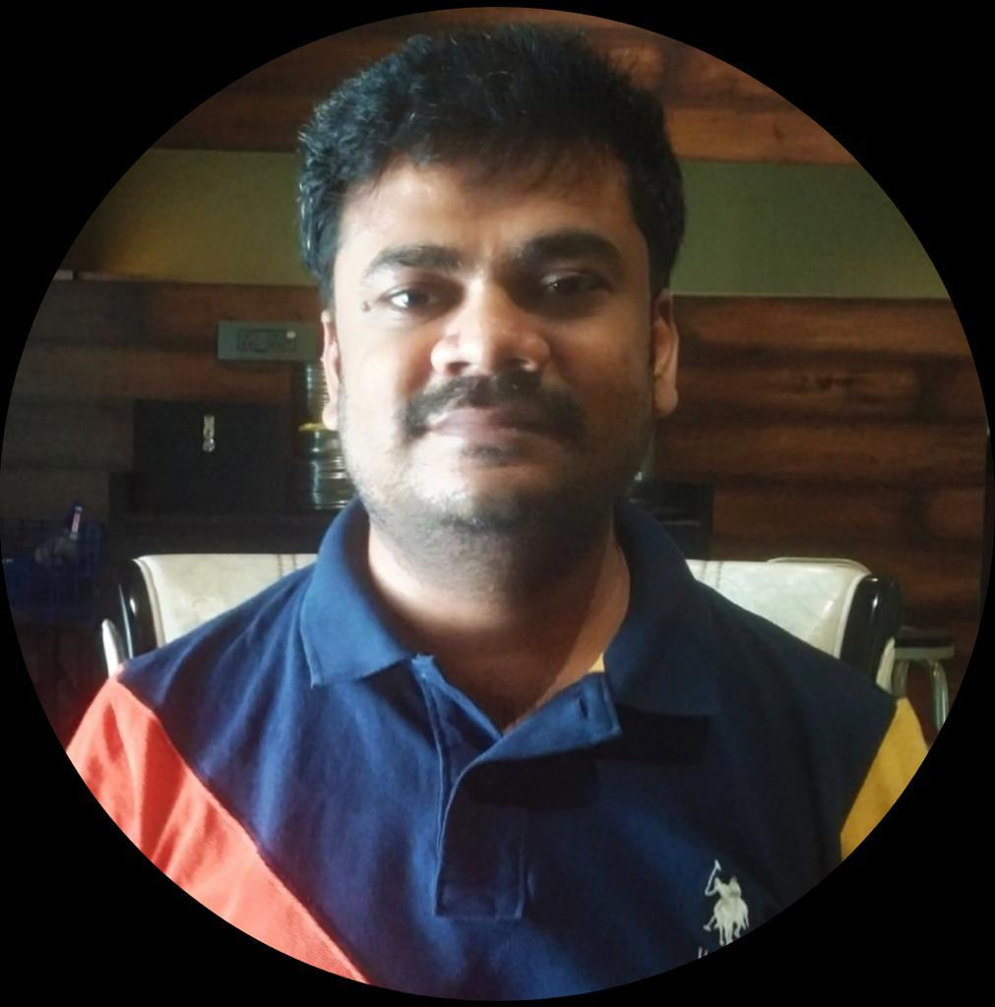
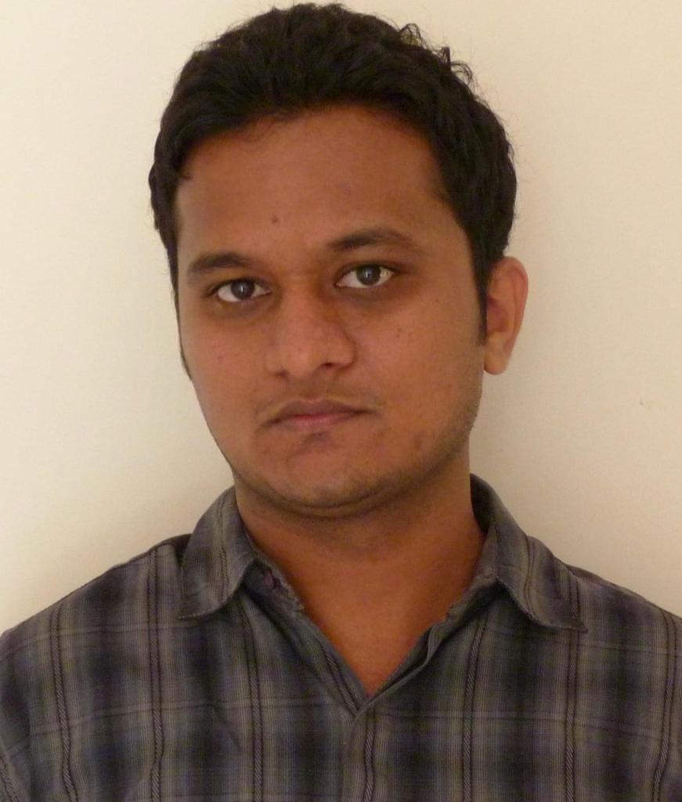

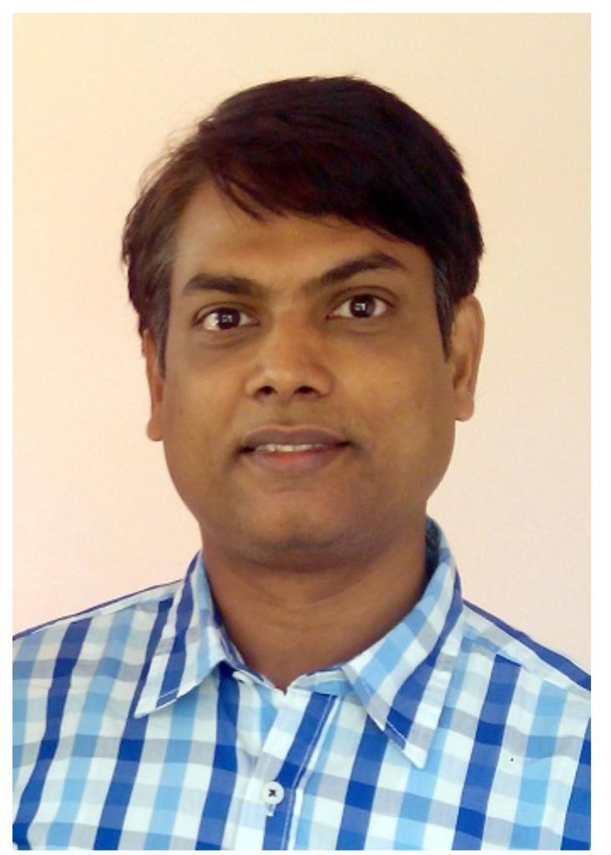
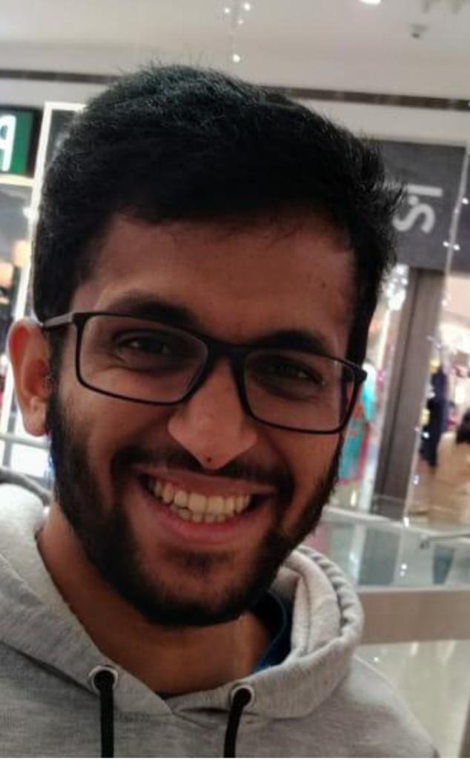
Capstone Team Members
Manikandan
Gopalakrishnan
Anand
Venkateshwaran
Ashley
Almeida
Vinuth
Tulasi
Shivanand
Kadadi
Project Guide
IISC – Dr. R Venkatesh Babu
Project Mentor
Talent Sprint – Ahmed

Slide 3
Problem Statement
Skin cancer is the most common cancer among all cancers.
Timely diagnosis is critical for its treatment before the onset of malignancy
Current practice, specialists rely on visual inspection with manual Dermoscopic assessment
In this project, we will make use of Dermoscopic Images and segment the lesion boundaries which can be used in the diagnosis and classification of early cancer

Slide 4
Project Motivation
Every year, nearly 17 million people are affected by cancer
Its incidence rate has risen to 4–6%
Early diagnosis is crucial as it increases the five-year survival rate up to 98%.
Motivation here is to solve the skin lesion segmentation, which is an important process in skin diagnostics, using deep neural networks which have been proven to be reliable.
Final solution can be integrated with a mobile / desktop application making the diagnosis tools more accessible.

Slide 5
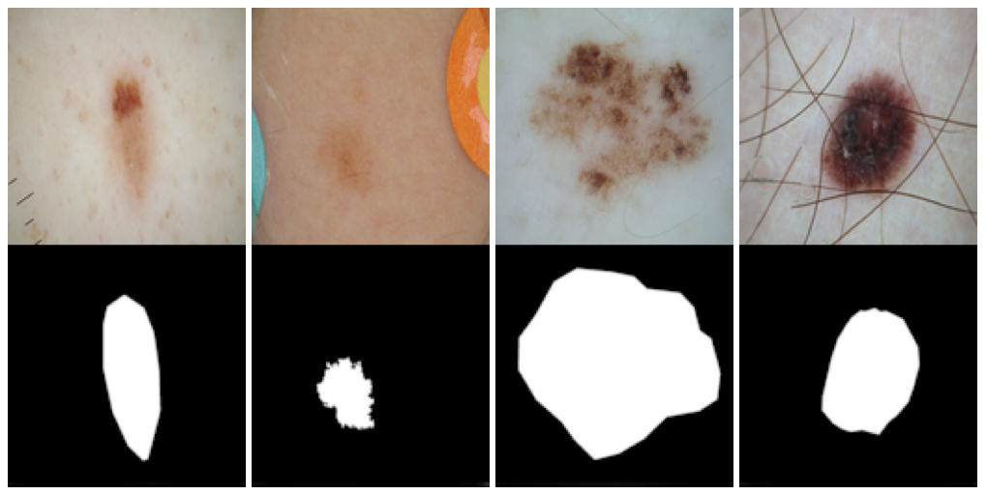
Dataset
Dermoscopic lesion images in JPEG format
Historical sample of patients presented for skin cancer screening
Every lesion image contains exactly one primary lesion; other fiducial markers, smaller secondary lesions
More benign lesions than malignant lesions
Training Data | Ground Truth | Test Data
2594 images | 12970 response masks (5 for each image). | 1000 images.

Slide 6
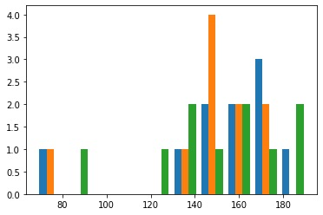
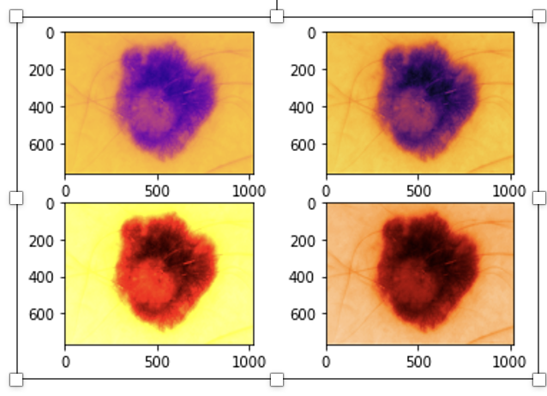
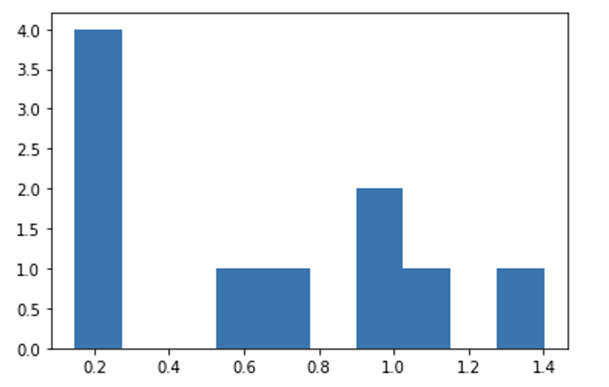
Pre-Processing
Data Extraction through web scraping and direct download from the source
Images brought in shape for further analysis
Checking for NULL values
Removing Outliers
Resource constraints led to downsizing of image size from 512x512x1 to 128x128x1
Color Intensity
Lesion Area Size (Cm)
Countour Maps

Slide 7
Models and Plan
1st Week: Exploratory Data Analysis, Dataset Finalization
2nd Week: Study research materials, finalize algorithms to implement
3rd Week: Implement UNet, U-Net++ and train the models
4th Week: Implement R2U-Net, Attention U-Net, SegNet & train the models
5th Week: Ensemble of 2 Best Models & train the models
6th Week: Compare Performances between Different Approaches and record Inferences and findings

Slide 8
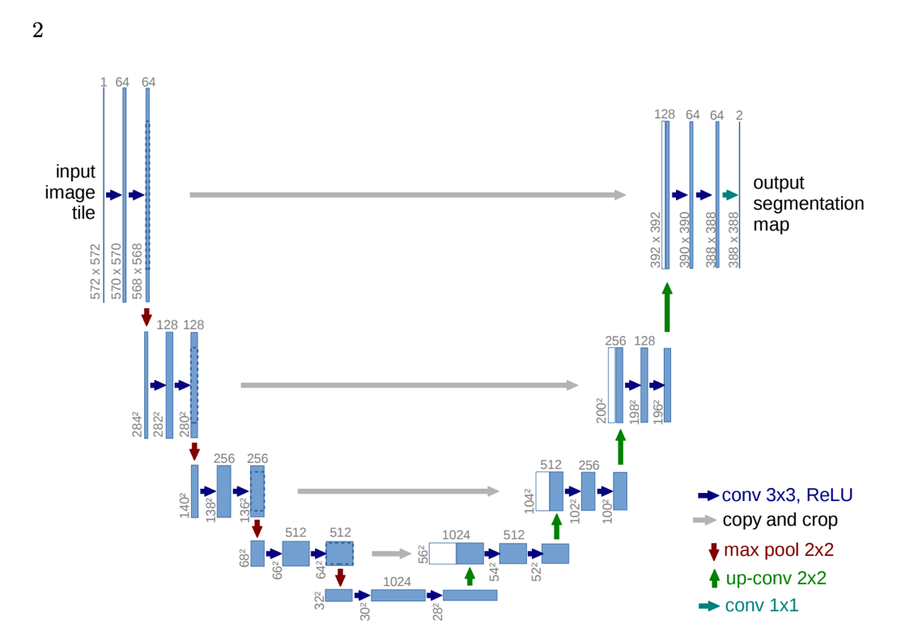
UNet

Slide 9
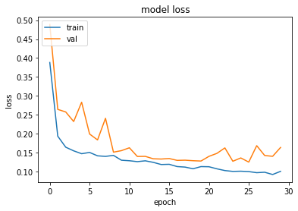
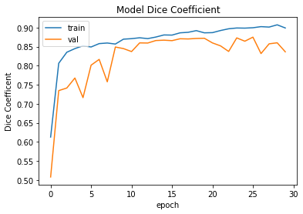
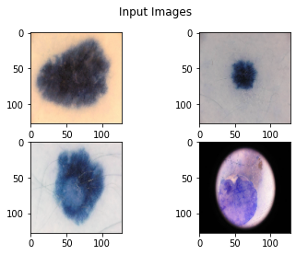
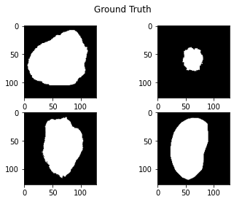
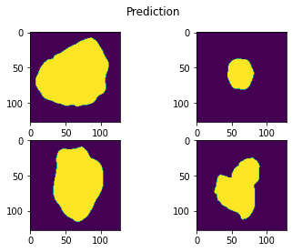
UNet
 | Accuracy | Precision | Recall | F1 | IOU / Jaccard
UNet | 0.95599 | 0.91538 | 0.8801 | 0.88089 | 0.80719

Slide 10
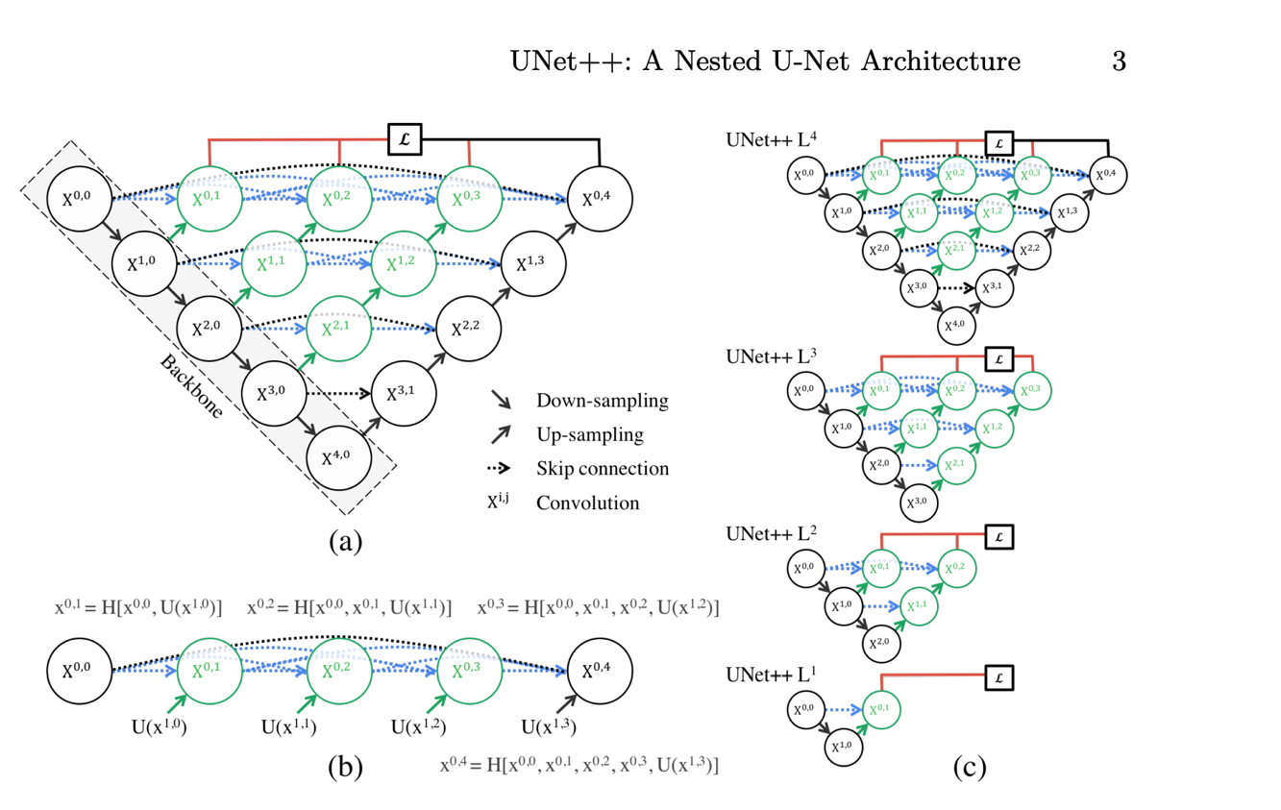
Unet ++

Slide 11
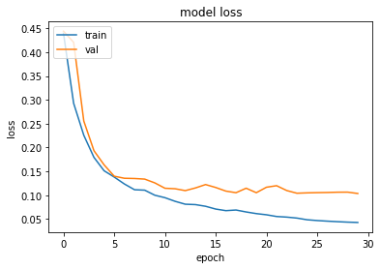
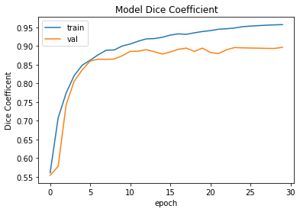
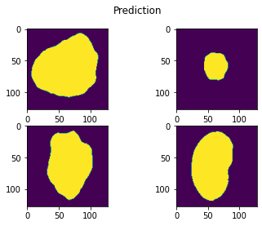
UNet ++
 | Accuracy | Precision | Recall | F1 | IOU / Jaccard
Unet ++ | 0.96484 | 0.91773 | 0.91757 | 0.90663 | 0.84123

Slide 12
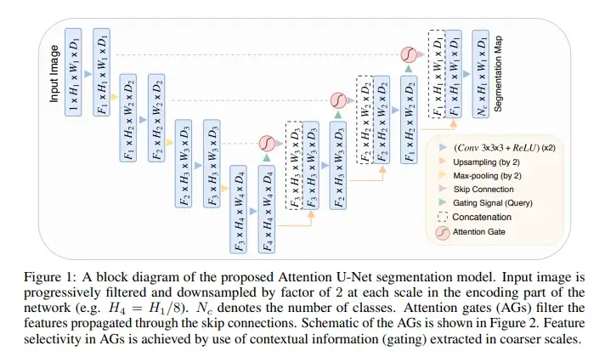
Attention UNet

Slide 13
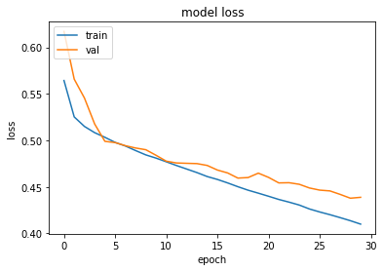
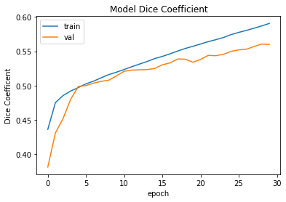
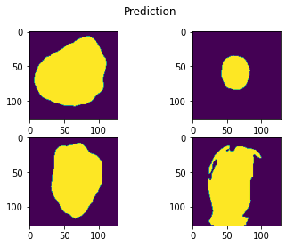
Attention UNet
 | Accuracy | Precision | Recall | F1 | IOU / Jaccard
Attention UNet | 0.93866 | 0.79181 | 0.91314 | 0.82186 | 0.72554

Slide 14
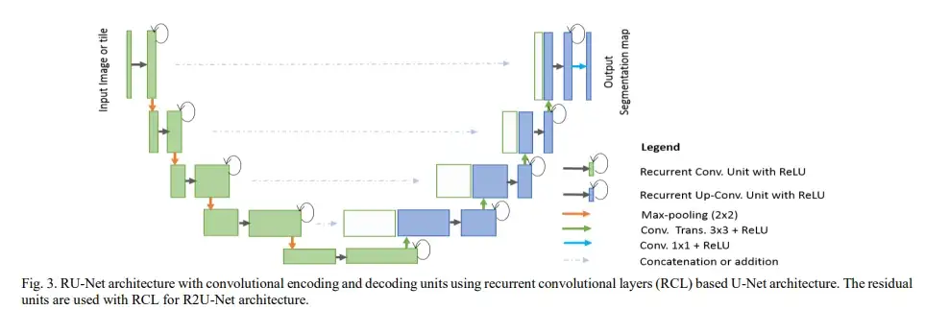
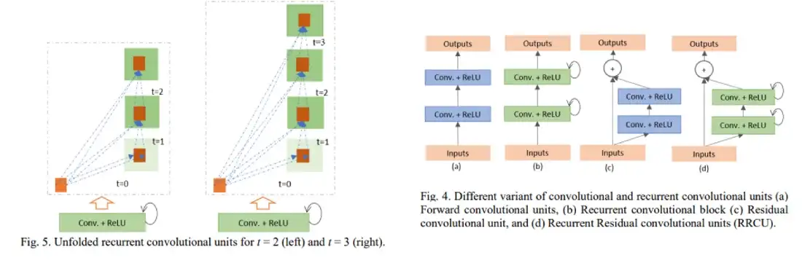
R2UNet

Slide 15
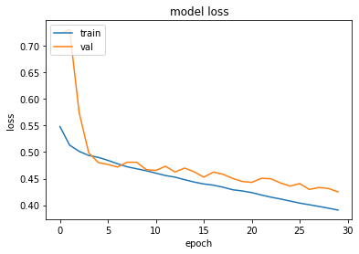
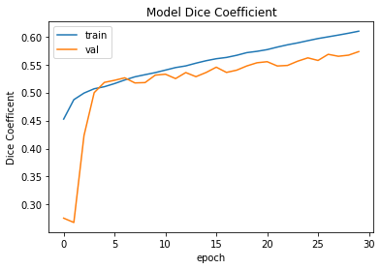
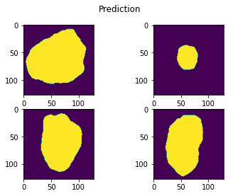
R2UNet
 | Accuracy | Precision | Recall | F1 | IOU / Jaccard
SegNET | 0.95445 | 0.88002 | 0.89181 | 0.86679 | 0.78359

Slide 16
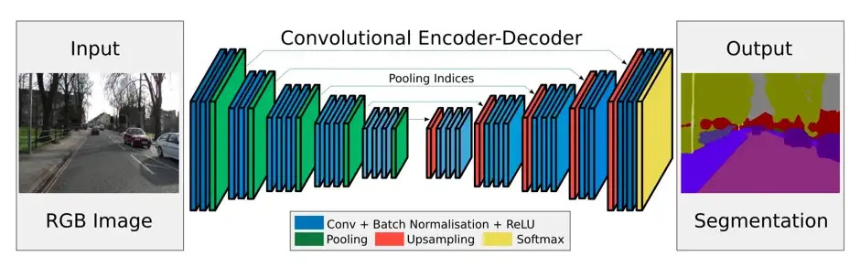
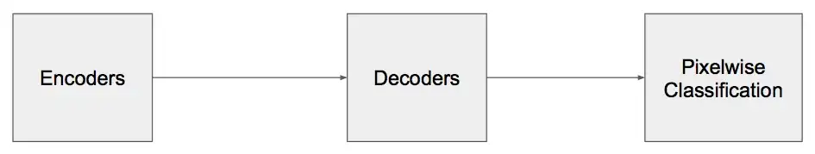
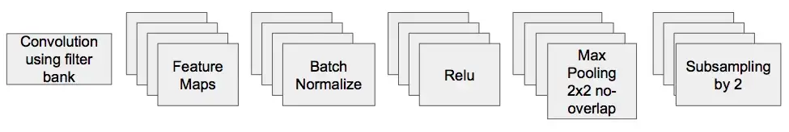
SegNet

Slide 17
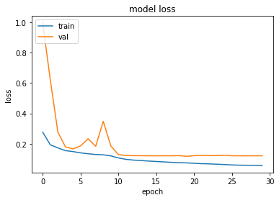
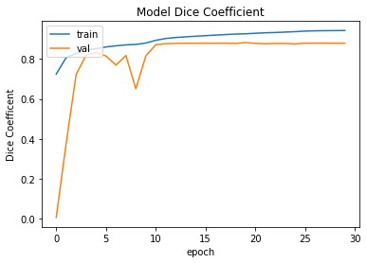
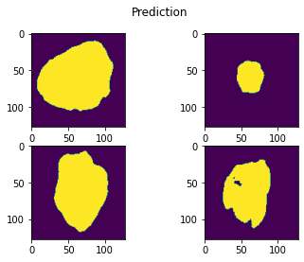
SegNet
 | Accuracy | Precision | Recall | F1 | IOU / Jaccard
R2UNet | 0.95306 | 0.88694 | 0.9015 | 0.87443 | 0.80412

Slide 18
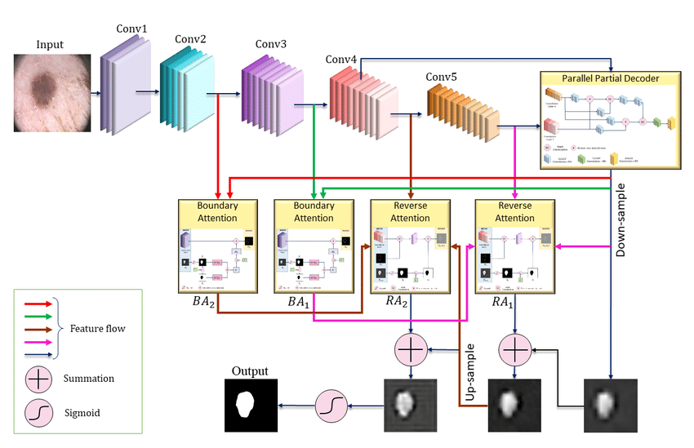
MFSNet

Slide 19
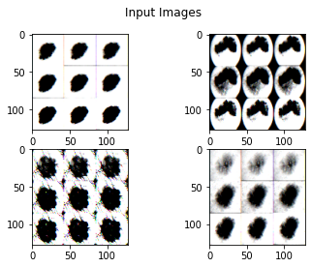
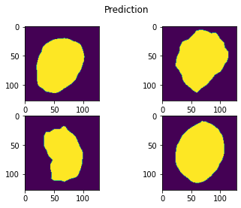
MFSNet
 | Accuracy | Precision | Recall | F1 | IOU / Jaccard
MFSNet | 0.91605 | 0.75602 | 0.82714 | 0.73333 | 0.60735

Slide 20
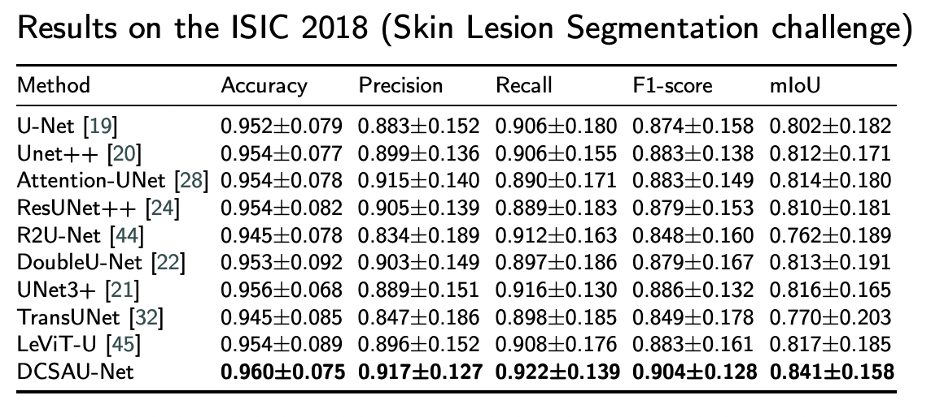
Model Benchmark and Performance
VGG16 – transfer learning
 | Unet | Unet ++ | AttentionNet | R2UNet | SegNET | MFSNet | Ensemble
Accuracy | 0.94977 | 0.96516 | 0.92737 | 0.95905 | 0.94933 | 0.95328 | 0.95323
Precision | 0.9623 | 0.97202 | 0.95303 | 0.9673 | 0.9611 | 0.96527 | 0.96466
Recall | 0.83299 | 0.92123 | 0.92215 | 0.90419 | 0.91213 | 0.91641 | 0.85087
F1 | 0.85349 | 0.90895 | 0.78256 | 0.88879 | 0.85237 | 0.83963 | 0.86999
IOU / Jaccard | 0.77792 | 0.84321 | 0.67925 | 0.81766 | 0.7611 | 0.74453 | 0.79665

Slide 21
Model Benchmark and Performance
EfficientNet – transfer learning
 | Unet | Unet ++ | AttentionNet | R2UNet | SegNET | MFSNet | Ensemble
Accuracy | 0.9564 | 0.95478 | 0.93091 | 0.95832 | 0.95456 | 0.95418 | 0.95828
Precision | 0.96603 | 0.96213 | 0.95052 | 0.96779 | 0.96306 | 0.83725 | 0.91177
Recall | 0.9099 | 0.86056 | 0.89672 | 0.91463 | 0.89664 | 0.90676 | 0.84282
F1 | 0.87968 | 0.84608 | 0.80228 | 0.88678 | 0.86838 | 0.84691 | 0.86244
IOU / Jaccard | 0.80303 | 0.75032 | 0.7024 | 0.81557 | 0.78651 | 0.75187 | 0.77443

Slide 22
Conclusions
Unet++ model scores are higher than benchmark scores when used along with VGG16
R2UNet model performs better when used along with EfficientNet
We have reduced our resolution to 128x128x1 due to resource constraints. Bilinear interpolation can be attempted to extrapolate to 512x512x1
MFSNet is a new emerging model and needs more work in fine tuning to get better results

Slide 23
Thank You
An awesome Teacher is hard to find,
difficult to part and impossible to forget
Project Guide
IISC – Dr. R Venkatesh Babu
Project Mentor
Talent Sprint – Ahmed
We would like to extend a hearty thanks to our Mentor Ahmed who has diligently spent a lot of time and guided us through the capstone project
And, also to Prof. Dr. Venkatesh Babu for his insights and his direction that has helped us successfully research and build these models

